Slide 1
Table of Contents
This slide deck consists of slides used in 2 lecture videos in Week 5. Below is a list of shortcut hyperlinks for you to jump into specific sections.
(page 2) Week 5: JSON/AJAX Overview
(page 15) Week 5: Building an AJAX Chat with Django
Notes:
Note from Chuck. If you are using these materials, you can remove my name and URL from this replace it with your own, but please retain the CC-BY logo on the first page as well as retain the entire last page when you remix and republish these slides.
TO Highlight – go to https://tohtml.com/html/ - paste and then do a "Paste RTF"

Slide 2

Using AJAX / JSON
Dr. Charles Severance
www.dj4e.com
https://samples.dj4e.com/chat
https://github.com/csev/dj4e-samples/tree/master/chat

Slide 3
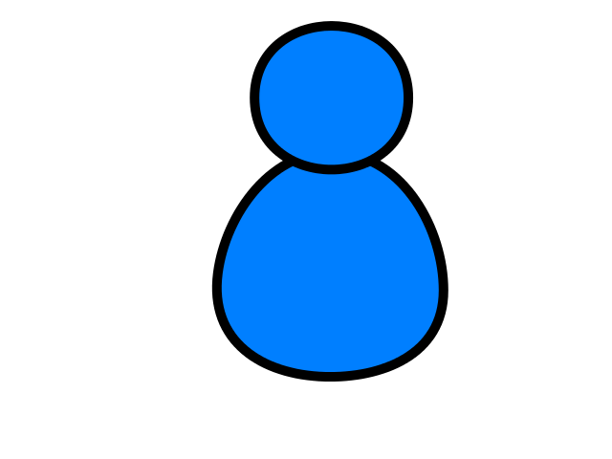
DOM
Browser
Linux
D
O
M
Django
settings.py
Routing
Click
urls.py
views.py
Parse
Response
Views
Templates
forms.py
JavaScript
Database
Shell
Models
model.py
/admin
admin.py

Slide 4
DOM
Browser
Linux
D
O
M
Django
settings.py
Routing
urls.py
views.py
Parse
Response
Views
Templates
forms.py
AJAX
JavaScript
Database
Shell
Models
model.py
/admin
admin.py

Slide 5
Data on the Web (2003)
With the HTTP Request/Response well understood and well supported, there was a natural move toward exchanging data between programs using these protocols.
We needed to come up with an agreed way to represent data going between applications and across networks.

Slide 6


Agreeing on a “Wire Format”
PHP
Array
JavaScript
Object
{
"name" : "Chuck",
"phone" : "303-4456"
}
Python
Dictionary
Java
HashMap
a.k.a. “Wire Protocol” - What we send on the “wire”

Slide 7

JSON is a “Wire Format”
Serialize
JavaScript
Object
Python
Dictionary
{
"name" : "Chuck",
"phone" : "303-4456"
}
De-Serialize

Slide 8
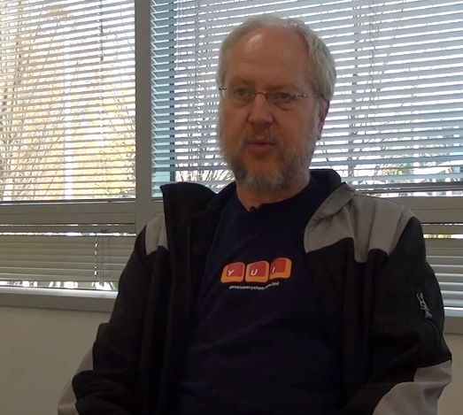
JavaScript Object Notation
Douglas Crockford – “Discovered” JSON
Object literal notation in JavaScript
https://www.youtube.com/watch?v=kc8BAR7SHJI

Slide 9
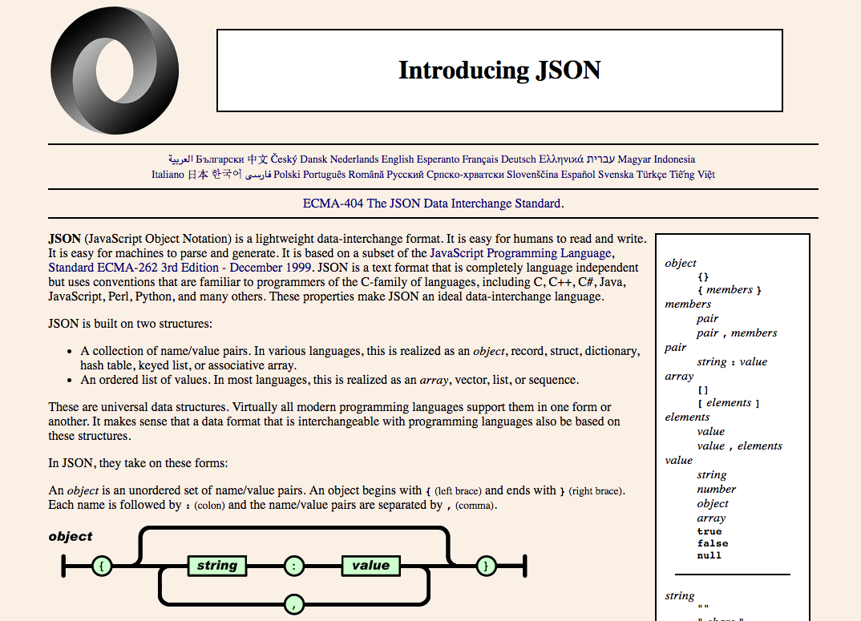
JSON.org
www.json.org
Derived from the JavaScript “constant” syntax
Similar to Python Dictionary syntax

Slide 10
JSON Syntax
who = {
"name": "Chuck",
"age": 29,
"college" : true,
"offices" : [ "3350DMC", "3437NQ" ],
"skills" : {
"fortran": 10,
"C++" : 5,
"C": 10,
"python" : '7'
}
};
String
Integer
Boolean
List/Array
Object
JSON Syntax

Slide 11
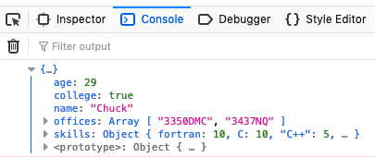
JSON Syntax
https://samples.dj4e.com/chat/syntax
<script type="text/javascript">
who = {
"name": "Chuck",
"age": 29,
"college": true,
"offices" : [ "3350DMC", "3437NQ" ],
"skills" : { "fortran": 10, "C": 10,
"C++": 5, "python" : 7 }
};
console.log(who);
</script>

Slide 12
JSON Syntax
https://samples.dj4e.com/chat/jsonfun
urls.py:
path('jsonfun', views.jsonfun, name='jsonfun'),
views.py:
import time
from django.http import JsonResponse
def jsonfun(request):
time.sleep(2)
stuff = {
'first': 'first thing',
'second': 'second thing'
}
return JsonResponse(stuff)

Slide 13
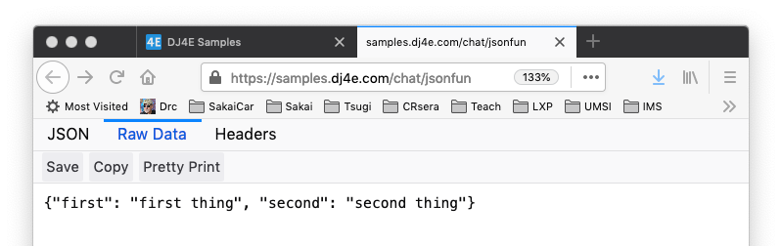
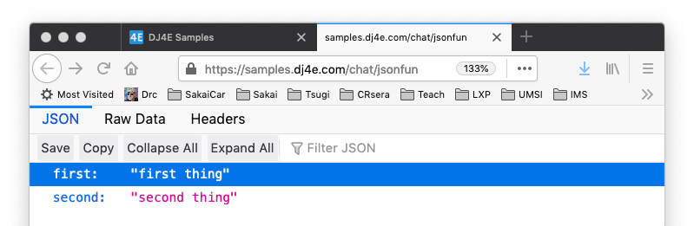
JSON
https://samples.dj4e.com/chat/jsonfun

Slide 14
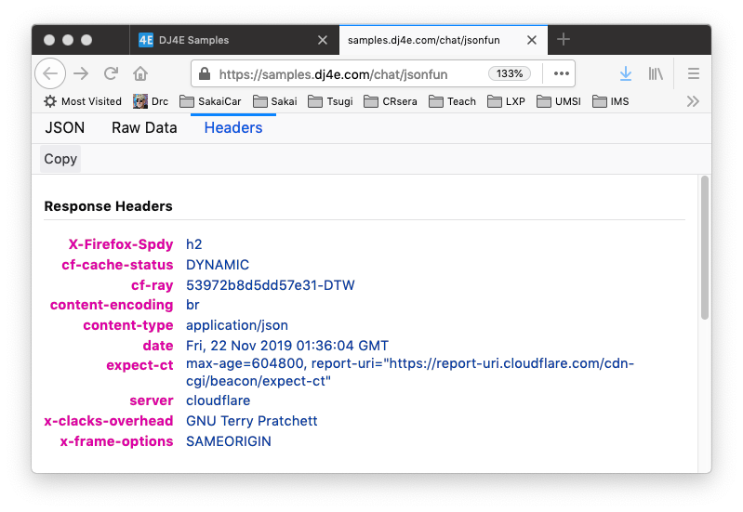
JSON
https://samples.dj4e.com/chat/jsonfun

Slide 15
A Chat App Using JSON

Slide 16
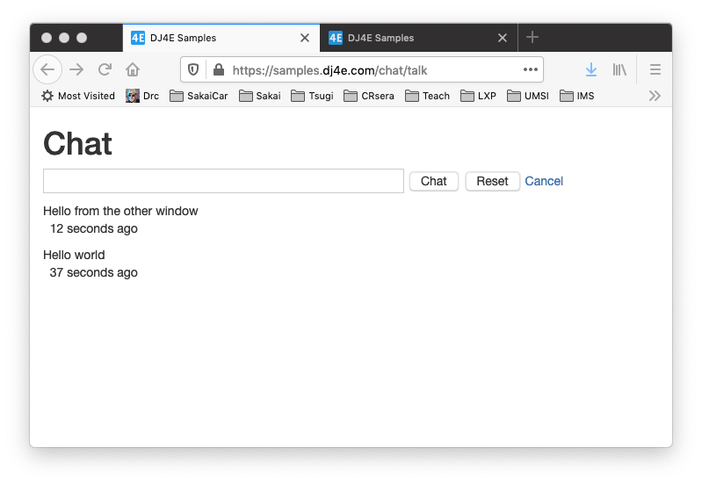
Chat App
https://samples.dj4e.com/chat/talk

Slide 17
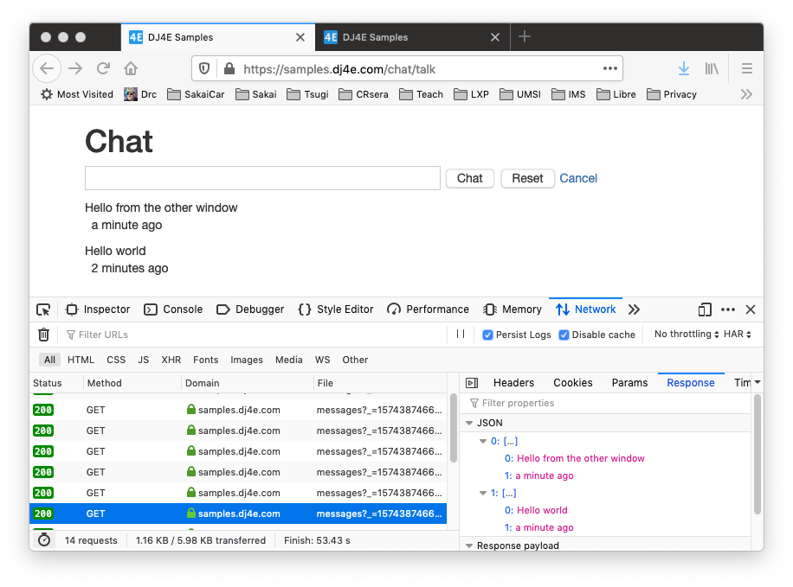
Chat App
https://samples.dj4e.com/chat/talk

Slide 18
Chat App
urls.py:
path('talk', views.TalkMain.as_view(), name='talk'),
path('messages', views.TalkMessages.as_view(), name='messages'),
url(r'^static/(?P<path>.*)$', serve,
{'document_root': os.path.join(BASE_DIR, 'static'), 'show_indexes': True},
name='static'
)
models.py:
class Message(models.Model) :
text = models.TextField();
owner = models.ForeignKey(settings.AUTH_USER_MODEL, on_delete=models.CASCADE)
created_at = models.DateTimeField(auto_now_add=True)
updated_at = models.DateTimeField(auto_now=True)

Slide 19
Chat App
https://samples.dj4e.com/chat/talk
views.py:
class TalkMain(LoginRequiredMixin, View) :
def get(self, request):
return render(request, 'chat/talk.html')
def post(self, request) :
message = Message(text=request.POST['message'], owner=request.user)
message.save()
return redirect(reverse('chat:talk'))

Slide 20
Chat App
https://samples.dj4e.com/chat/talk
templates/chat/talk.html (1 of 3):
{% extends 'base_bootstrap.html' %}
{% block content %}
<h1>Chat</h1>
<form method="post">
{% csrf_token %}
<input type="text" name="message" size="60"/>
<input type="submit" value="Chat"/>
<input type="submit" name="reset" value="Reset"/>
<a href="{% url 'chat:main' %}" target="_blank">Cancel</a>
</p>
</form>
<div id="chatcontent">
<img src="{% url 'chat:static' 'spinner.gif' %}" alt="Loading..."/>
</div>

Slide 21
Chat App
https://samples.dj4e.com/chat/talk
templates/chat/talk.html (2 of 3):
<script type="text/javascript">
function updateMsg() {
console.log('Requesting JSON');
$.getJSON('{% url 'chat:messages' %}', function(rowz){
console.log('JSON', rowz);
$('#chatcontent').empty();
for (var i = 0; i < rowz.length; i++) {
arow = rowz[i];
$('#chatcontent').append('<p>'+arow[0] +
'<br/>&nbsp;&nbsp;'+arow[1]+"</p>\n");
}
setTimeout('updateMsg()', 4000);
});
}
[
["Hello from the other window", "13 minutes ago"],
["Hello world", "14 minutes ago"]
]

Slide 22
Chat App
https://samples.dj4e.com/chat/talk
templates/chat/talk.html (3 of 3):
// Make sure JSON requests are not cached
$(document).ready(function() {
$.ajaxSetup({ cache: false });
updateMsg();
});
</script>
{% endblock %}

Slide 23
Chat App
https://samples.dj4e.com/chat/messages
views.py:
class TalkMessages(LoginRequiredMixin, View) :
def get(self, request):
messages = Message.objects.all().order_by('-created_at')[:10]
results = []
for message in messages:
result = [message.text, naturaltime(message.created_at)]
results.append(result)
return JsonResponse(results, safe=False)
[
["Hello from the other window", "13 minutes ago"],
["Hello world", "14 minutes ago"]
]

Slide 24
Chat App
https://samples.dj4e.com/chat/talk

Slide 25
Summary
JSON is very simple and powerful.
It is well supported and performance in many languages.
JavaScript / jQuery and Python/Django have excellent support.

Slide 26
Acknowledgements / Contributions
These slides are Copyright 2010- Charles R. Severance (www.dr-chuck.com) as part of www.dj4e.com and made available under a Creative Commons Attribution 4.0 License. Please maintain this last slide in all copies of the document to comply with the attribution requirements of the license. If you make a change, feel free to add your name and organization to the list of contributors on this page as you republish the materials.
Initial Development: Charles Severance, University of Michigan School of Information
Insert new Contributors and Translators here including names and dates
Continue new Contributors and Translators here

Slide 27
Additional Source Information
Image of Douglas Crockford is Copyright Charles R. Severance and licensed as CC-BY

